Slide 1
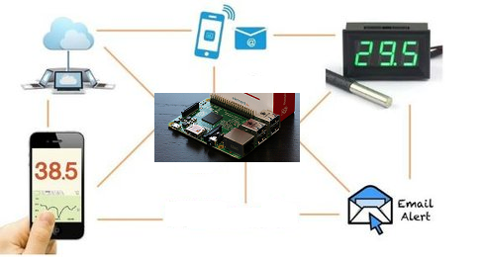

M.S. Ramaiah Institute of Technology, Bangalore Department of Computer Science and Engineering Project Based Learning(IoT): Wireless Temperature Monitoring System
Submitted by
Sanjana K.S (1MS12CS098)
Vidit Jain (1MS12CS127)
Vignesh P (1MS12CS128)
Vishal H (1MS12CS132)

Slide 2
OVERVIEW
Project Goals
Description about Sensors
Description about the SRS
Description about the Design Architecture with Class Diagram and Sequence Diagram
Implementation details
Results
Conclusion and Future work
Bibliography

Slide 3
PROJECT GOALS
1.Remotely measure the inside and outside room temperature.
This is done by using Putty and VNC Viewer with the help of DS18B20 sensors
2.Send a Gmail alert when the temperature exceeds the threshold value.
Achieved using python code and SMTP.
3.Take a picture of the surroundings when the temperature exceeds the threshold value and send it along with the Email.
Achieved using python code and Raspberry Pi camera module
4.Update the temperature values in an open source cloud access it from anywhere.
PrivateEyePi is the open source cloud used for this purpose.
5.A mobile application to check the temperature value
RaspiCheck is used for this purpose.
6.Providing persistent offline storage of temperature readings.
Database in MySQL is created for this purpose.

Slide 4
DESCRIPTION ABOUT SENSORS
Two DS18B20 sensors are used in this project. This semiconductor temperature sensor offers high accuracy and high linearity over an operating range of about 55 degree centigrade to 150 degree centigrade. It is an integrated circuit, and can therefore include extensive signal processing circuitry within the same package as the sensor thus eliminating additional circuitries. This sensor can be directly connected to the Raspberry pi’s GPIO pin and thus capable of direct and reliable communication with it. Other features are that it’s lightweight and has a wide power supply range (2.7 V to 5.5 V) and converts the temperature to a digital value in less than 1s. The ID’s of the sensors used are 28_031462453fff and 28_04146467c8ff.
A raspberry pi camera module is also used to take a picture of the surroundings when the temperature value exceeds the threshold value. The Raspberry Pi camera module can be used to take high-definition video, as well as stills photographs. It’s easy to use for beginners, but has plenty to offer advanced users if you’re looking to expand your knowledge.

Slide 5
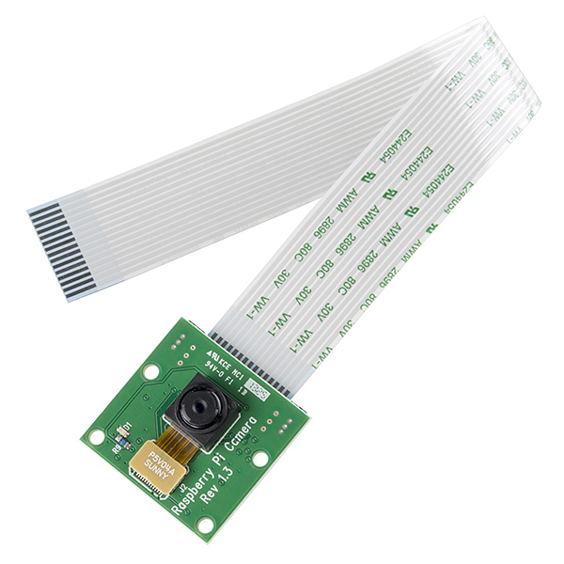
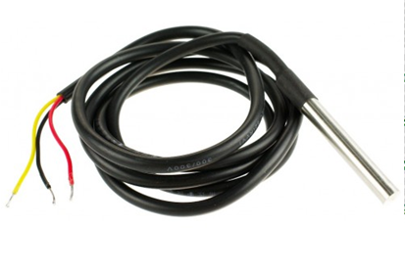
SENSORS USED
Figure 1 DS18B20 sensors
Figure 2 Raspberry Pi camera module

Slide 6
DESCRIPTION ABOUT SRS
External Interface Requirements
User Interfaces: The user interfaces include cloud interface, mobile application interface and Virtual Network Computing Interface. The requirements of the user interfaces are that it needs to be highly interactive, efficient, and attractive but should yet be simple and must possess a sleek look. Also the interface must be able to accept input from a variety of devices and display the information in an organized manner using graphs and calendar which depicts the inside and outside room temperature.
Hardware Interfaces: RaspberryPi2 Model B is the hardware device which is responsible for co-coordinating various activities with respect to the project. It is the core component of the project. Further DS18B20 sensors are used to measure the inside and outside room temperature. RaspberryPi2 along with the sensors and the camera module acts as the hardware interface to the wireless temperature monitoring system project.

Slide 7
Software Interfaces: A python code is written to read the raw temperature and it’s parsed to obtain the actual temperature which is then updated to the database and open source cloud and also if the inside room temperature exceeds the threshold value then an email alert with a photo is sent. Thus the python code together with the library routines act as the software interface to the wireless temperature monitoring system project.
Communication Interfaces: An end user can communicate with the project over the internet using the cloud service or by using the mobile application. The user can communicate with the sensors and RaspberryPi board using Putty and VNC viewer. Also filezilla helps in transferring files or data between RaspberryPi and windows. SMTP is the communication protocol used to send Emails to the intended recipient.

Slide 8
FUNCTIONAL REQUIREMENTS
Functional Requirement 1.1: User Registration- PrivateEyePi open source cloud service. The User fills in the all the required fields during the registration process in order to use the cloud service.
Functional Requirement 1.2: Remotely Accessing RaspberryPi. The user can remotely access the RaspberryPi by using Angry IP Scanner which gives the IP address of the Pi and this address is used to establish a telnet connection using Putty and virtual network connection using VNC viewer.
Functional Requirement 1.3: Cloud Authentication. If the user has already registered with PrivateEyePi then the next time he opens the cloud service it will have to authenticate the login details that has been provided by him.
Functional Requirement 1.4: Database Access. The user can access the data i.e. the temperature readings from the database that is stored on the SD card of raspberry pi (offline storage)
Functional Requirement 1.5: Cloud Access. The user can access the temperature readings from the cloud (online storage) from anywhere and thus it provided persistent storage. Also the user can analyze the graph reports and the calendar which gives logs of past temperatures.

Slide 9
Functional Requirement 1.6: Camera Module. The raspberry pi camera module can be used to take still photographs.
Functional Requirement 1.7: Gmail Alert. When the temperature exceeds the threshold value an Email is sent along with a photo of the surroundings by using SMTP.
Functional Requirement 1.8: RaspiCheck Android application. This application remotely connects to the terminal of RaspberryPi and can be used for obtaining the current inside and outside room temperature.
Functional Requirement 1.9: Wireless Connectivity. Tenda wireless USB adapter is used so that the sensors continuously measure the temperature and this can be remotely accessed.
Functional Requirement 1.10: Temperature Measurement. Two DS18B20 sensors are used to measure the inside and outside room temperature.
Functional Requirement 1.11: Database. The database is used for storing temperature values and providing offline storage.

Slide 10
SOFTWARE SYSTEM ATTRIBUTES
Reliability: The reliability of the system will be in terms of as to how accurate the temperature readings are sensed by DS18B20 and also the lifetime of the board and the sensors. As lifetime is high, reliability is also high.
Availability: The availability of the system refers to the system’s capability to be in the on state throughout i.e. 24*7. This means the sensors need to continuously sense the temperature and this sensed is constantly updated to the open source cloud so that it can be accessible from anywhere. It includes system availability, Internet connection availability.
Security: The system needs to be secure and safe and must prevent security attacks which could violate the goals or might manipulate the RaspberryPi. It includes system security and cloud account security.
Portability: The code that is used for measuring the temperature needs to be portable i.e. the same code should run on any version of RaspberryPi. This is called architecture neutrality. Also the application needs to be portable across a wide range of operating systems.
Maintainability: The system needs to be continuously monitored and maintenance service has to be provided if the system’s performance has degraded due to some glitch. It includes application extensibility and application testability.

Slide 11
Performance: The system’s performance is measured in terms of responsiveness, efficiency and user experience. A system with high performance is desired. Performance is high if the throughput is high, latency is low, response time is less and system dependability exists. The changes in the actual temperature must be monitored.

Slide 12
PERFORMANCE REQUIREMENTS
Response Time- The cloud gets updated within 2 minutes but the database updates and the taking picture and mailing it gets done within 1minute.
Workload- Even if the workload on the system is increased the performance doesn’t degrade as RaspberryPi has a RAM of 1GB.The workload will be continuous and uniform as the temperatures have to be measured throughout the day.
Scalability- The number of users accessing the temperature from the Pi will just be the owner but the number of users accessing the data over the cloud will vary and thus is scalable.
Platform- The performance of the system depends on the platform that the application is run upon which NOOBS (New out Of Box Software) runs.

Slide 13
DATABASE REQUIREMENTS
Only a single table called temps is used with the field’s sensor id, current time, and current date, inside and outside room temperature value and picture of the surroundings. The database is mainly used to provide offline storage feature for the application.
Here the image and the temperature values are measured in real time and thus the database has real time requirements.
Moreover the database is highly dynamic as the data in it constantly gets updated at the end of the day. MySQL is used as it’s simple and easy to write queries in it and also it’s efficient for Relational Database Management Systems.
Python code is used for the front end configuration and MySQL is used for back end configuration.

Slide 14
DESIGN CONSTRAINTS
Hard drive space: The amount of space an application needs for storage and execution purpose is major design limitation as RaspberryPi uses a SD card for persistent storage.
Application memory Usage: The amount of memory space needed for an application to run is an important limitation in the design as RaspberryPi has only 1GB RAM and it needs to effectively utilize it.
Budget: The amount of money that can be spent in the overall development of the project restricts the design of the system.
Application Quality: If the quality of the application is high then it means that the design is highly effective. Thus the quality of the application is an important deciding factor in the design of an application.

Slide 15
OTHER REQUIREMENTS
Implementation Requirement: Coding must be done in python.
Loading OS Requirement: Since RaspberryPi has an HDMI output port and most display devices have a VGA input. So an HDMI-VGA adapter is mandatory for loading the OS and also 14inch monitor is needed.
Network Requirement: In order to remotely access RaspberryPi, the Wi-Fi network on the system that is remotely accessing it must be shared over the Ethernet LAN cable connection between the system and RaspberryPi.
SD card Requirement: The SD card that is used for loading OS and which provides persistent storage for Raspberry Pi must be of class 10 or higher.
Jumper Wire Requirement: Only female-female jumper wires are needed and not male-male jumper wires.

Slide 16
DESIGN ARCHITECTURE
With the help of an efficient and simple python code we are able to achieve all the desired functionalities of the wireless temperature monitoring system.
The design architecture is shown in figure 3. It gives the highest level of abstraction of the wireless temperature monitoring system as it acts like the system’s skeleton. Basically it’s a component diagram indicating the different modules present in the system and communication among the modules.
The core module is the Rapsberrypi2 board and there are many other smaller modules like DS18B20 sensors, RaspberryPi Camera, Cloud module, database module and Gmail Alert Module.
This system architecture successfully portrays the entire system’s details with the highest level of abstraction by not plunging into the details of the implementation.

Slide 17
Figure 3 System architecture

Slide 18
CLASS DIAGRAM
In software engineering, a class diagram in the Unified Modelling Language (UML) is a type of static structure diagram that describes the structure of a system by showing the system's classes, their attributes, operations (or methods), and the relationships among objects.
The figure 4 in the next slide represents the class diagram for wireless temperature monitoring system which uses association, aggregation, composition and generalization and many more features of the class model.
The relationship among various classes and their interdependencies are effectively modeled using the class diagram.
There are two types of storage namely cloud storage and database storage. Thus these classes inherit the storage class.
Image class depicts the image that is taken by the camera module. This again is inherited by different classes which correspond to different image formats. Remote access can be either through cloud or Android application. Alerts include Gmail as well as cloud based alerts. Temperature is displayed either in degree Celsius or degree Fahrenheit.

Slide 19
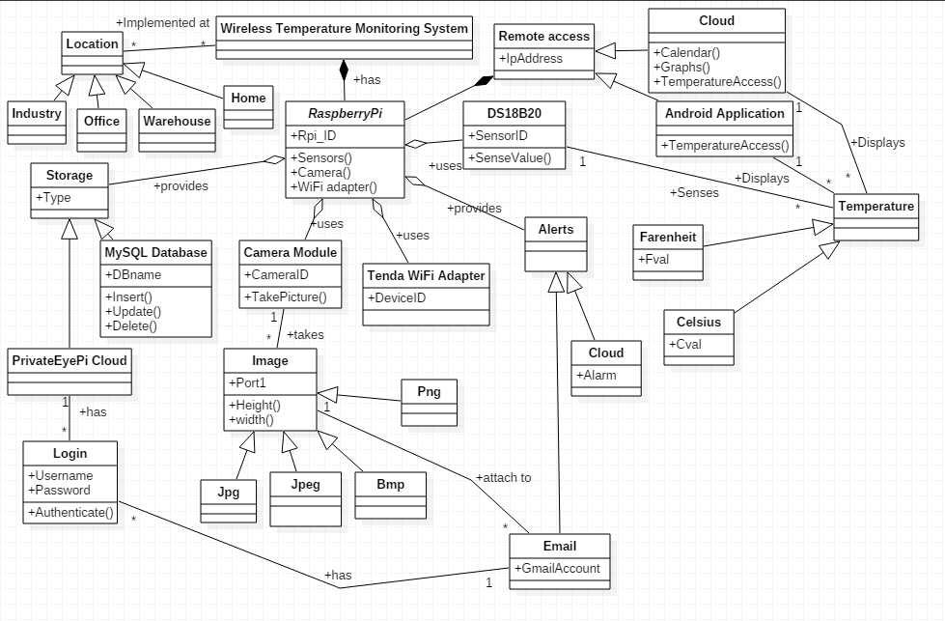
Figure 4 Class Diagram

Slide 20
SEQUENCE DIAGRAM
Its used to describe the order i.e. the sequence in which the events are to be executed
In figure 5 and figure6 we can see that the user initiates the sequence of events by sending their credentials. Later this is authenticated and on successful authentication it sends the acknowledgement back to the user.
The user can then access the respective features i.e. the cloud or Gmail.
Similarly the sequence diagrams for working of the project , data access and remote access are given in the following slides describing the sequence in which the activities occur and the relationship or interdependencies among them.
A class diagram only shows the static nature of the system where as the sequence diagram shows the dynamic nature and relationships among different classes.

Slide 21
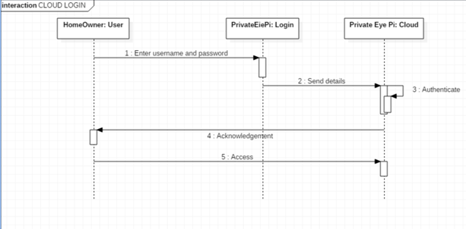
Figure 5 Cloud Login

Slide 22
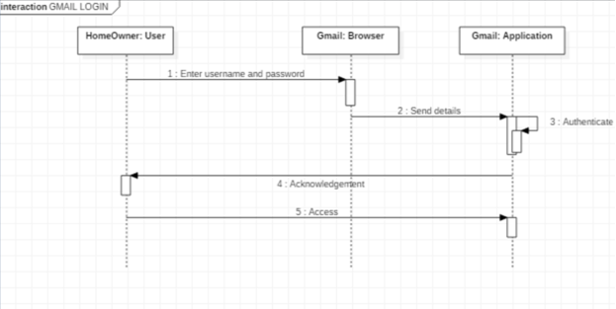
Figure 6 Gmail Login

Slide 23
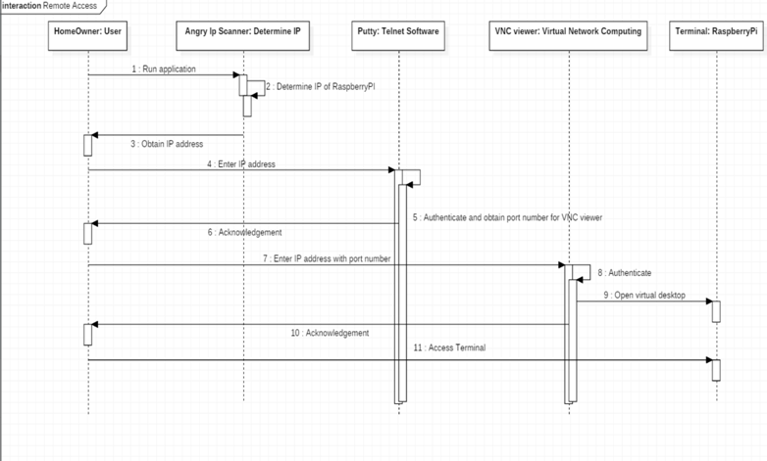
Figure 7 Remote Access

Slide 24
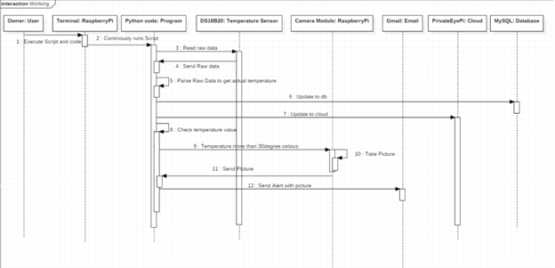
Figure 8 Working

Slide 25
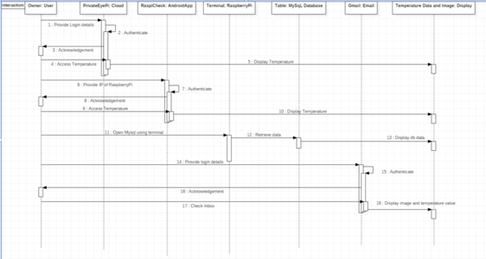
Figure 9 Data Access

Slide 26
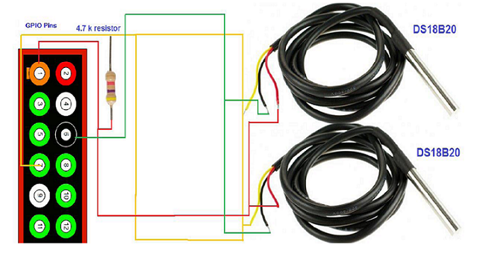
IMPLEMENTATION
The connections are made as shown in figure 10. For initially loading the OS into Raspberry Pi2 we use monitor, keyboard and mouse.
Figure 10 Pin Diagram

Slide 27
TOOLS AND TECHNOLOIES USED
Various software applications are used namely
SD card Formatter to initially erase all the data on the SD card.
Angry IP scanner to detect the IP addresses of all devices connected to a Wi-Fi network.
Putty is a SSH telnet software which is used to remotely access the Raspbian OS’s terminal.
VNC viewer is used to access the virtualized Raspbian OS.
Python is used for developing and writing the code to remotely access the raw temperature and parse it to obtain the actual temperature and also to send Gmail Alerts along with pictures of the surroundings if the temperature exceeds the threshold value.
MySQL database for offline persistent storage.
PrivateEyePi open source cloud.
RaspiCheck Android application.
Tenda Wi-Fi adapter.

Slide 28
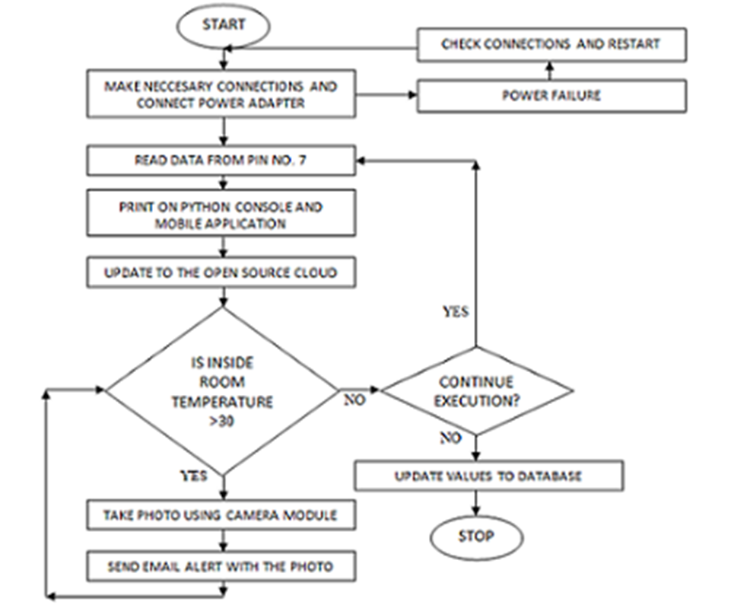
Figure 11 Flow Chart

Slide 29
INITIAL SETUP
Configure raspberry pi by loading NOOBS.
Identify sensors using Linux commands
sudo modprobe w1-gpio
sudo modprobe w1-therm
Cd /sys/bus/w1/devices
We found the sensor ids to be 28_031462453fff and 28_04146467c8ff
The raw temperature can be obtained by using the following commands shown in the diagram given in the next slide.
Then the raspberry pi is remotely accessed using angry IP scanner and Putty.
Later VNC viewer is used to access the Raspbian OS’s GUI.

Slide 30
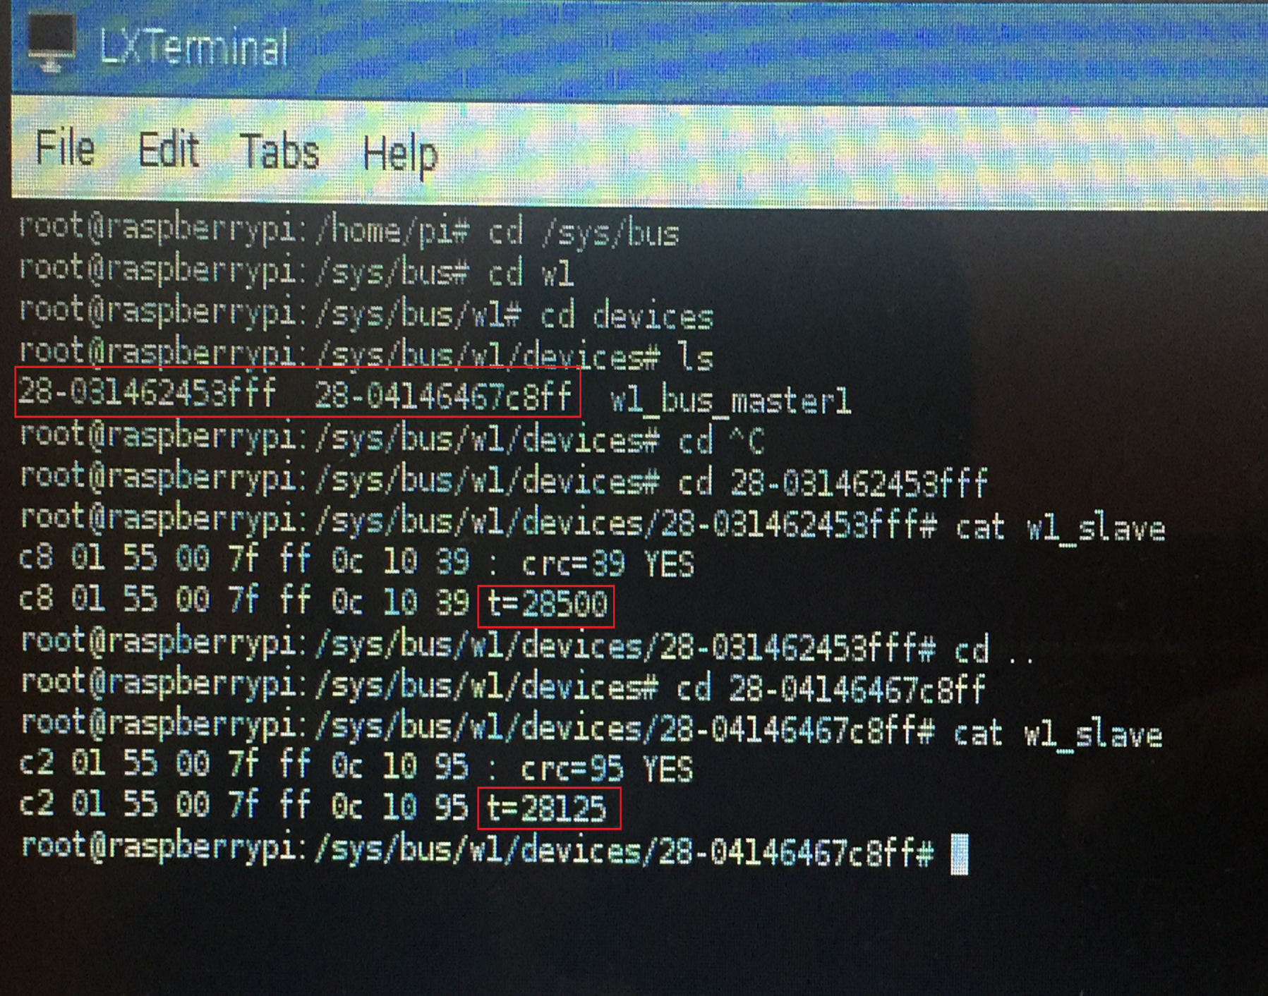
Figure 12 Initial Setup

Slide 31
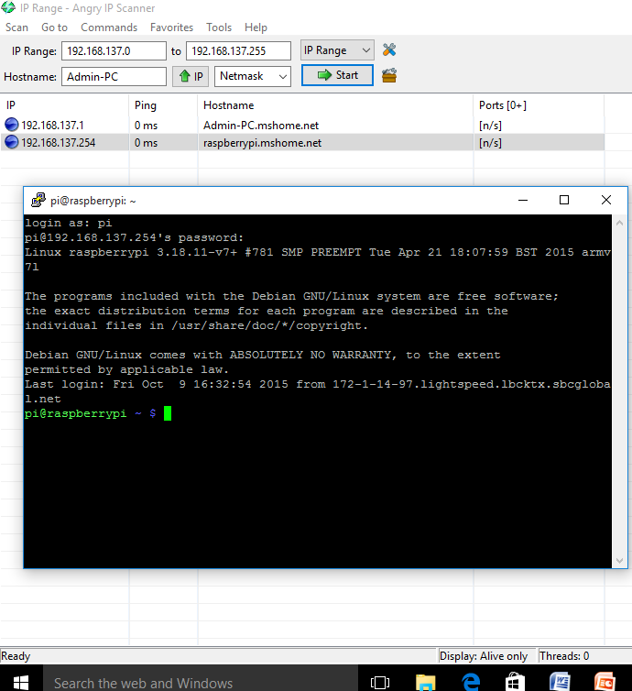
Figure 12 Remotely accessing raspberry pi

Slide 32
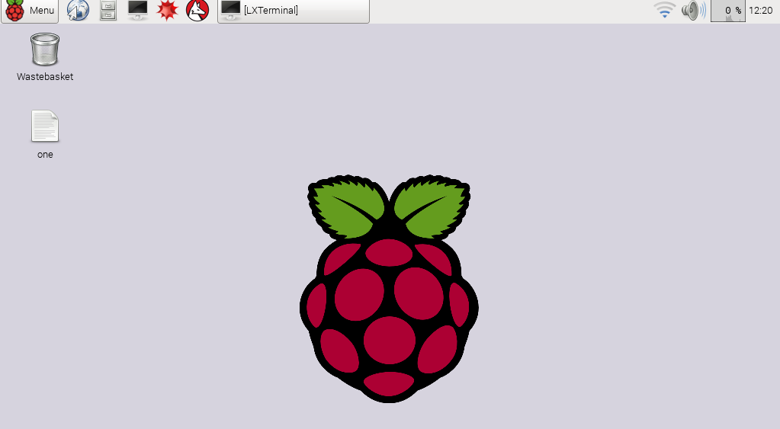
Figure 13 Remotely accessing Raspberrypi using VNCviewer

Slide 33
DESIGN INTRODUCTION
In order in to optimize the design process and also to ensure that the design is efficient and the final product designed meets the desired requirements and achieves the goals and objectives of the project, it is essential to divide the project into various components or modules whose description has to be defined clearly.
Modular design, or "modularity in design", is a design approach that subdivides a system into smaller parts called modules or skids, which can be independently created and then used in different systems. A modular system can be characterized by functional partitioning into discrete scalable, reusable modules, rigorous use of well-defined modular interfaces, and making use of industry standards for interfaces.
The different modules needed and their description for the wireless temperature monitoring system are given below
Remote Temperature Measurement Module: This module is responsible for retrieving the raw data from the DS18B20 sensors and parses it to obtain the actual temperature and the temperature can be accessed remotely using Putty and VNCviewer.
Camera Module: This module is responsible to interfacing with the raspberry pi camera module and to take a picture of the surroundings when the room temperature exceeds the threshold value.

Slide 34
Database Module: This module’s function is to update the data into the backend MySQL database using python code.
.Cloud Module: This module’s function is to update the temperature values into the cloud so that it can be accessible anywhere
Email Module: This module’s function is to send an Email alert to the intended recipient’s Gmail account if the temperature exceeds the predefined value using python code.
Mobile App Module: This module’s function is to remotely connect to the raspberry pi and determine the current inside and outside room temperature using RaspiCheck Android Application.

Slide 35
ALGORITHM
Input: RaspberryPi with all the necessary connections.
Output: Updating Temperature values to cloud, database and sending Email Alert
1. Rd ← Raw data from DS18B20sensors
2. P (Rd) // parsing the raw data to obtain the actual temperature values.
3. Update inside and outside room temperatures to the cloud.
4. While(InsideRt > 30 ) //InsideRt refers to inside room temperature
5. Img ← Picture taken using raspberry pi camera module
6. Send Email Alert with Img as attachment
7. Update temperature values to database.
8. Loop back to step 1

Slide 36
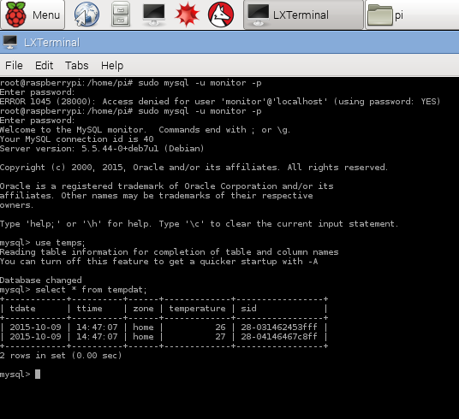
RESULTS
All the intended objectives of the project has been successfully achieved and the correct temperature values are update to the cloud and also inserted into the database.
This has been shown in figure 14-20.
Figure 14 Database

Slide 37
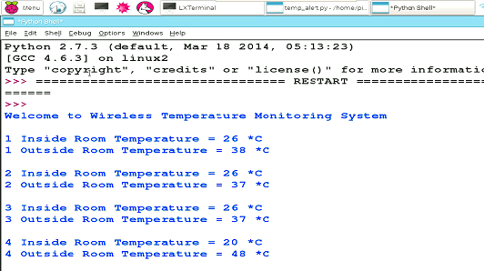
By using a python code the raw temperature is converted to get the actual temperature which is printed on the console after every 5seconds.
Also the temperature readings are inserted into a database whose backend is configured using Mysql.
Figure 15 Console

Slide 38
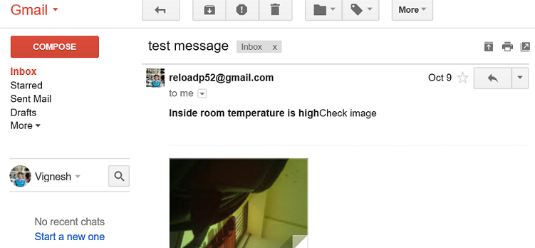
GMAIL ALERT
When the inside room temperature exceeds a predefined limit a Email alert is sent to the intended recipient using python.
Also a photo is taken and is stored on the remote system from which raspberry pi is accessed.
Figure 16 Gmail Alert

Slide 39
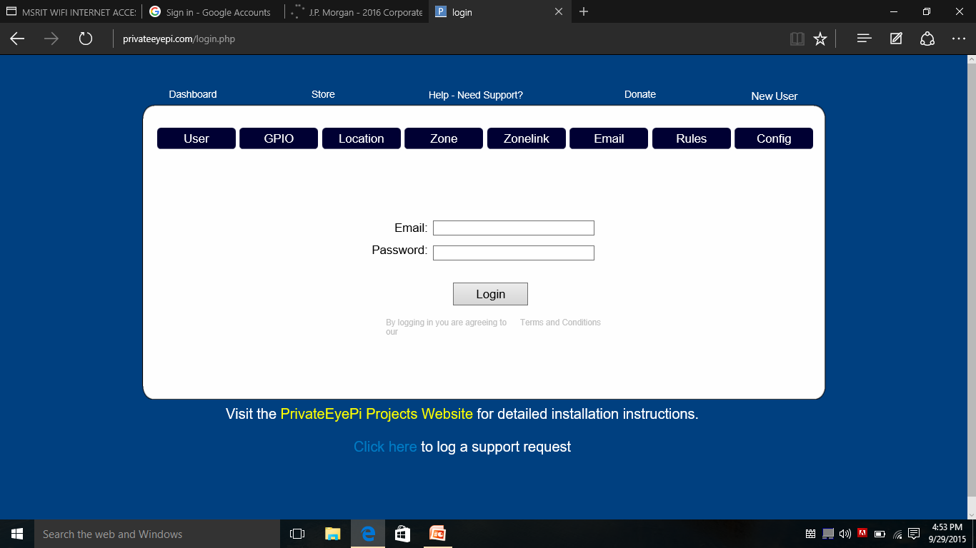
CLOUD ACCESS
The temperature that is being constantly sensed is also simultaneously stored in an open source cloud called privateeyepi which is best suited for cloud storage with respect to raspberry pi.
The login page for cloud access is shown below.
Figure 17 Cloud Access

Slide 40
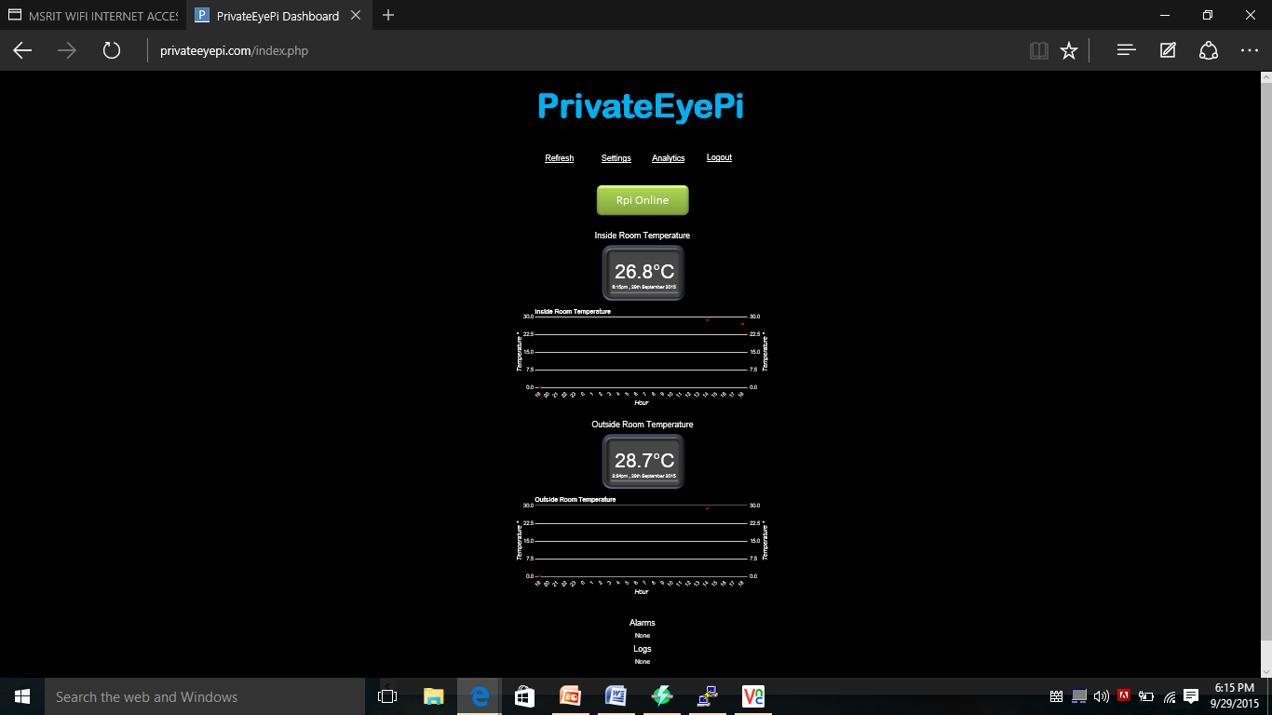
Rather than just storing the temperature values in the open source cloud various features like graphs and calendars are used to keep track of the past temperature data and also provide analysis of data that is being stored in the cloud.
The dashboard along with graphs for Inside room temperature and Outside room temperature is shown below.
Figure 18 Cloud Access

Slide 41
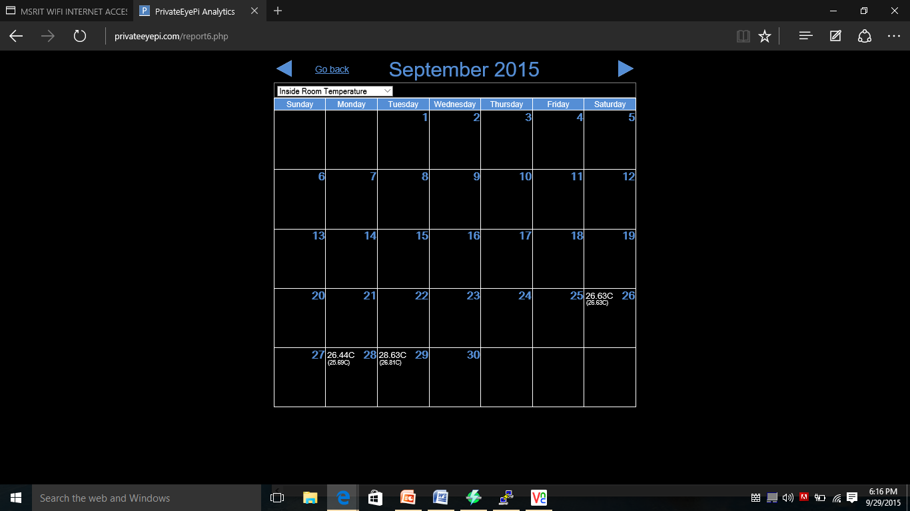

Figure 19 Calendar for Inside Room temperature
Figure 20 Calendar for Outside room temperature

Slide 42
CONCLUSION AND FUTURE WORK
Thus we have designed a wireless temperature monitoring system that is capable of remotely measuring the temperature and updating the values to the cloud and database and also send Gmail alerts along with pictures when the temperature exceeds the user defined limit.
All of the objectives of the project have been successfully completed and the desired results have been obtained.
We would like to extend this project by examining or analyzing the effectiveness and the responsiveness of the open source cloud and to find out ways to improve them. Mobile notifications and Amazon Web Services’ SNS (Simple notification service) can be integrated to the wireless temperature monitoring system in order to have a much broader scope and range in terms of the notifications that are sent to the intended recipients apart from the Gmail alerts, cloud updates and database updates.

Slide 43
BIBLIOGRAPHY
The following online links were used
https://en.wikipedia.org/wiki/Wiki
https://www.raspberrypi.org/
http://www.projects.privateeyepi.com/home/temperature-gauge
http://www.element14.com/community/thread/34969/l/wireless-monitoring-system-using-raspberry-pi?displayFullThread=true
http://www.slideshare.net/KrishnaKumar272/smart-wireless-surveillance-monitoring-using-raspberry-pi
http://datasheets.maximintegrated.com/en/ds/DS18B20.pdf
The following books were very helpful
Raspberry Pi User Guide by Eben Upton and Gareth Halfacree.
Raspberry Pi Projects for the Evil Genius by Donald Norris.
Shan and M. Richardson Getting Started with Raspberry pi, 2012 :O'Reilly Media, Inc

